Slide 1
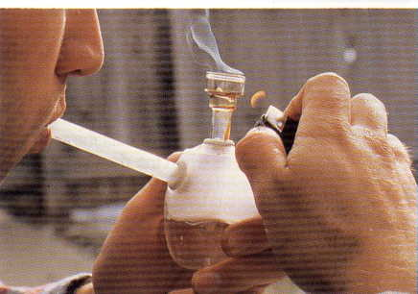
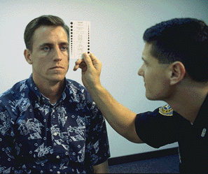
Review of the DRE School

Slide 2
How do we define the term “drug” for DRE purposes?
“Any substance that, when taken into the human body, can impair the ability of the person to operate a vehicle safely”

Slide 3
Basic Drug Statistics
What drug, other than alcohol, was found most frequently in the Los Angeles Field Validation Study?
What does “polydrug use” mean?
How common was polydrug use in the Los Angeles Field Validation Study?

Slide 4
Basic Drug Statistics
How good were the DREs in the Field Validation Study?
In the University of Tennessee Study, what percentage of injured drivers had drugs other than alcohol in them?

Slide 5
Review of Symptomatology
Name six different CNS Depressants
Name four different CNS Stimulants
Name two naturally-occurring Hallucinogens
Name four different synthetic Hallucinogens

Slide 6
Review of Symptomatology
Name a major analog of PCP
Name the three sub-categories of Inhalants
What is the active ingredient in Cannabis?

Slide 7
Review of Vital Signs: Pulse Rate
Define “Pulse”
True or False: Pulse rate is measured in units of “millimeters of mercury”
Name three different pulse point
Indicate where they are located
What is the “average” range of adult human pulse rate, for DRE purposes?

Slide 8
Review of Vital Signs: Blood Pressure
Define “Blood Pressure”
Name the instrument used to measure blood pressure
When does blood pressure reach its highest value?
What is the highest value called?

Slide 9
Review of Vital Signs: Blood Pressure
When does blood pressure reach its lowest value?
What is the lowest value called?
What is the “average” range of adult human blood pressure, for DRE purposes?
What does “Hg” stand for?

Slide 10
Review of Eye Examinations: Horizontal Gaze Nystagmus
What are the three validated clues of impairment that have been established for HGN?
What formula expresses the approximate statistical relationship between BAC and the Angle of Onset of Nystagmus?
What categories of drugs usually will cause HGN?

Slide 11
Review of Eye Examinations: Vertical Gaze Nystagmus
True or False: Any drug that causes HGN may also produce VGN
What category of drugs causes VGN but not HGN?

Slide 12
Review of Eye Examinations: Lack of Convergence
True or False: Any drug that causes nystagmus will also usually cause the eyes to be unable to converge
What category of drugs usually causes LOC but does not cause nystagmus?

Slide 13
Review of Darkroom Examinations
What are the three lighting conditions under which we must estimate the size of the subject’s pupils?
How long should we wait in the Darkroom before beginning to check the subject’s pupils?
Name the device we use to estimate the size of the subject’s pupils

Slide 14
Review of Darkroom Examinations
What do the numbers on the Pupillometer refer to?
In what units of measurement are those numbers given?
For DRE purposes, what is the “average” range of an adult pupil in room light?
What does the term “Miosis” mean?

Slide 15
Review of Darkroom Examinations
What does the term “Mydriasis” mean?
What category of drugs usually causes Miosis, or constricted pupils?
What categories usually cause Mydriasis, or dilated pupils?
What is unique about the drug Methaqualone (Quaaludes) and Soma?

Slide 16
Review of Divided Attention Tests
Name the four Divided Attention Tests administered during the DRE drug influence evaluation

Slide 17
Review of Divided Attention Tests
Why is the MRB the first test administered?
What four validated clues of impairment have been established for the OLS Test?
How many times is the OLS administered during the DRE drug influence evaluation?

Slide 18
Review of Divided Attention Tests
Which foot must the subject stand on first when performing the OLS?
How many validated clues of impairment have been established for the WAT test?
Name them
In what sequence is the subject instructed to touch the index fingers to the nose on the FTN test?

Slide 19
General Review Questions
What is the medical or technical term for “droopy eyelids”?
What does “Piloerection” mean?
What drug often causes Piloerection?
What is the medical or technical term for Heroin?

Slide 20
General Review Questions
Explain the terms “Null”, “Additive”, “Antagonistic,” and “Overlapping” Effect as they apply to polydrug use
Give examples
What is “Rebound Dilation”?
What is pupillary unrest?
What does “Bruxism” mean?

Slide 21
General Review Questions
What does the number denoting the size of a hypodermic needle refer to?
What does “Synesthesia” mean?
What is “Sinsemilla”?
What are the twelve major components of the DRE drug influence evaluation?

Slide 22
Review of Physiology
Name the ten major body systems

Slide 23
Review of Physiology
What is the distinction between the “Smooth” muscles and the ”Striated” muscles?
What do we call the chemicals produced by the Endocrine System?
What is a neuron?

Slide 24
Review of Physiology
What do we call the space between two nerve cells?
What do we call the chemicals that pass from one nerve cell to the next?
What do we call the part of the nerve cell that sends out the neurotransmitter?

Slide 25
Review of Physiology
What do we call the part of a nerve cell that receives the neurotransmitter?
What do the Sensory Nerves do?
What do the Motor Nerves do?
Name the two sub-divisions of Motor Nerves

Slide 26
Review of Physiology
Name the two sub-divisions of Autonomic Nerves
Describe their functions
What does it mean to say a drug is “sympathomimetic”?
What does it mean to say a drug is “parasympathomimetic”?

Slide 27
Review of Physiology
Which two categories of drugs can most appropriately be called sympathomimetic?
Which category can most appropriately be called parasympathomimetic?
What is an artery?
What is a vein?

Slide 28
Review of Physiology
What are the Pulmonary Arteries?
What is unique about them?
What are the Pulmonary Veins?
What is so special about them?

Slide 29
Questions?

